Slide 1
From genomics to herd improvement: Pioneering strategies in dairy cattle breeding
John B. Cole
Department of Animal Sciences, Donald Henry Barron Reproductive and Perinatal Biology Research Program, and the Genetics Institute, University of Florida, Gainesville
Department of Animal Science, North Carolina State University, Raleigh
Department of Animal Biosciences, University of Guelph, Ontario, Canada
Embrapa Gado de Leite| November 10, 2025

Slide 2
Topics
Current landscape
Genomic prediction methods
Genomic tools
Adoption by industry
Selection goals
Future directions
Acknowledgments

Slide 3
Current landscape

Slide 4

Dairy cattle selection before genomics
Slow!
  Progeny test for production took 3–4 years from insemination
  Bull at least 5 years old before first evaluation available
Expensive!
  Progeny testing cost US$25,000–50,000 (R$125,000–R$250,000) per bull
  Only 1 in 10 bulls graduated from progeny test
  At least US$200,000 (R$1,000,000) invested in each active bull
  Average active bulls cost about US$400,000 (R$2,000,000)

Slide 5
Why genomics works for dairy cattle
Extensive historical data available
Well-developed genetic evaluation program
Widespread use of artificial insemination
Progeny-test programs
High-value animals worth the cost of genotyping
Long generation interval that can be reduced substantially by genomics

Slide 6
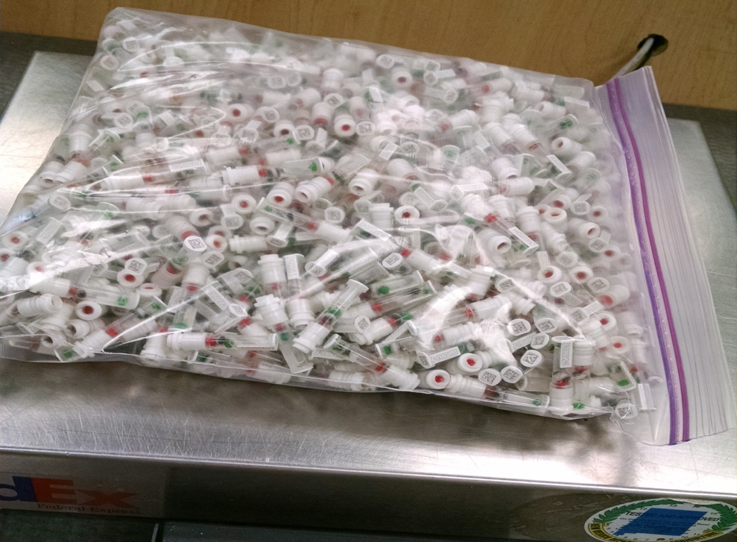
Usable genotypes by year and sex
Zoetis

Slide 7
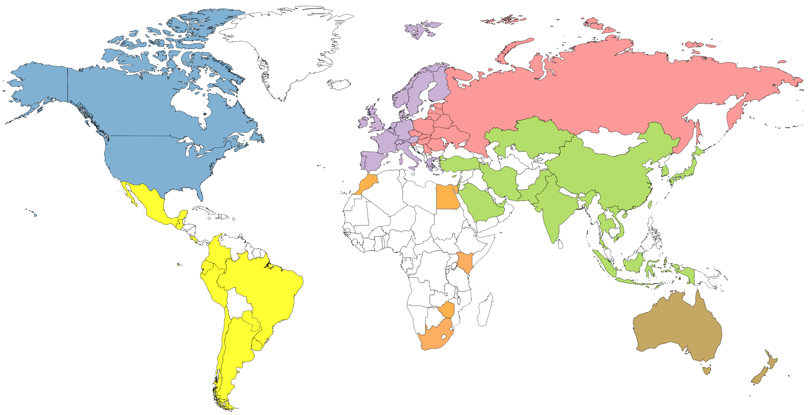
Genotyped animals in database (May 2025)
826,506
240,787
7,315,447
1,024,347
497,713
44,493
179,258

Slide 8
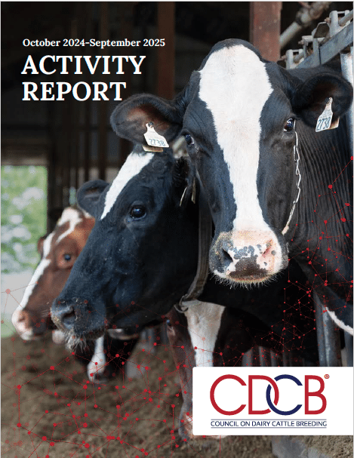
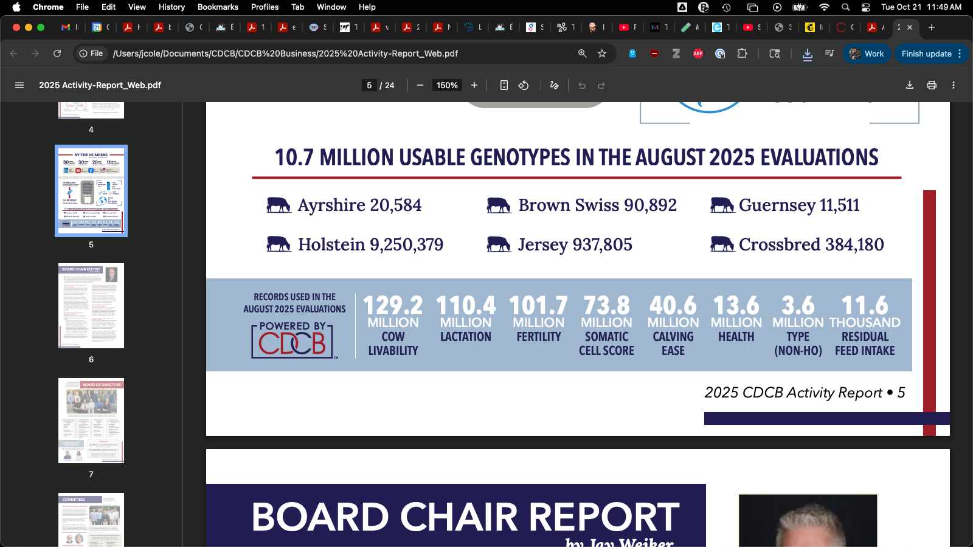
How much data do we have?
CDCB (2025; https://uscdcb.com/wp-content/uploads/2025/10/Activity-Report_Web.pdf)

Slide 9
Genomic prediction methods

Slide 10

How does genetic selection work?
ΔG = genetic gain each year
reliability = how certain we are about an animal’s predicted genetic merit (genomics ⬆)
selection intensity = how selective we are when picking mates (management can ⬆)
genetic variance = genetic variation in the population (we can’t really change this)
generation interval = time between generations (genomics ⬇)
Cole and Spurlock (2016; https://ldhm.adsa.org/)

Slide 11
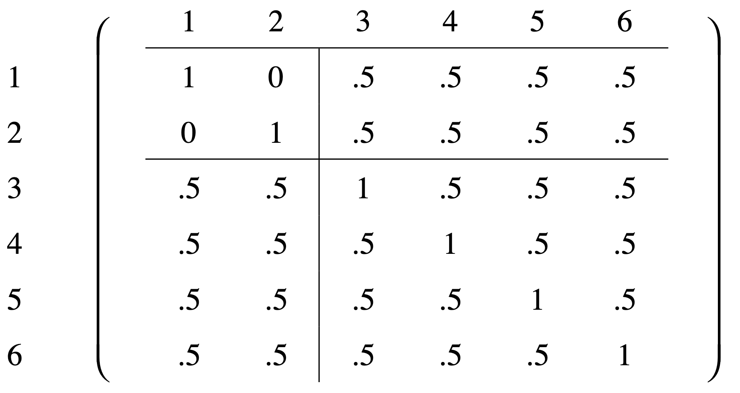
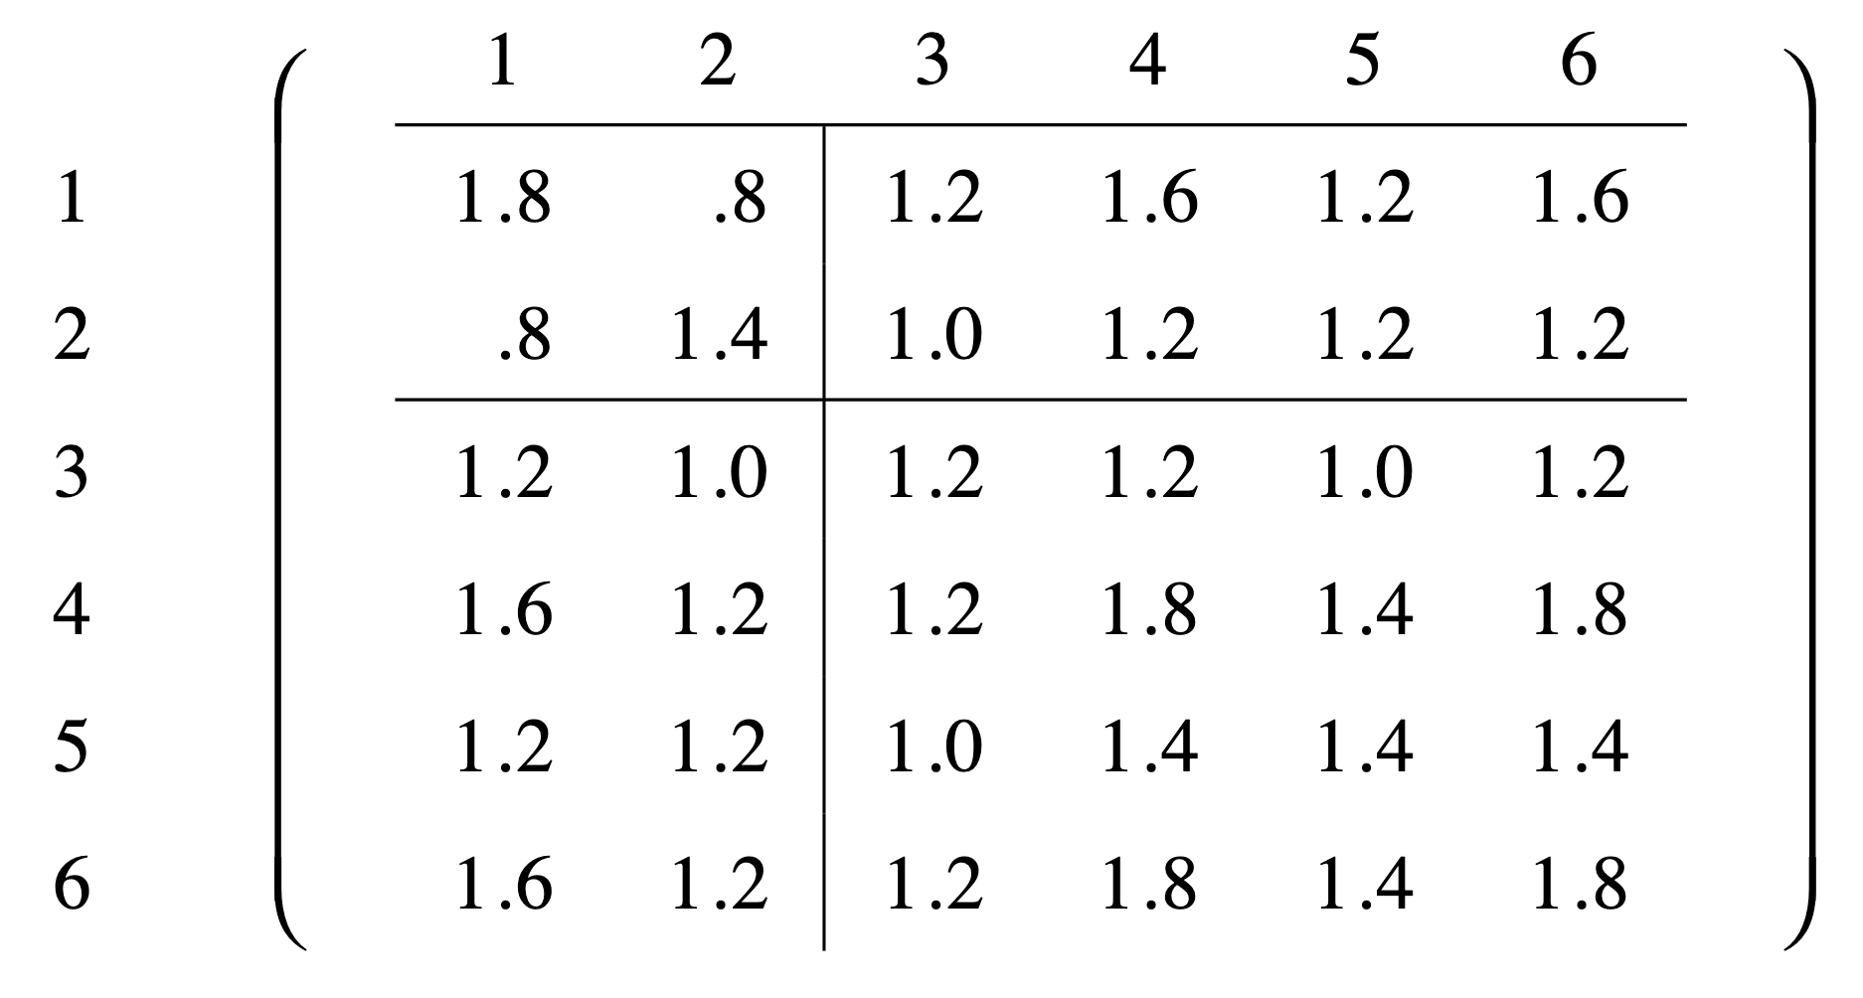
Allelic relationship matrices
Pedigree-derived A
Allelic-based A
Nejati-Javaremi et al. (1997; https://doi.org/10.2527/1997.7571738x)

Slide 12
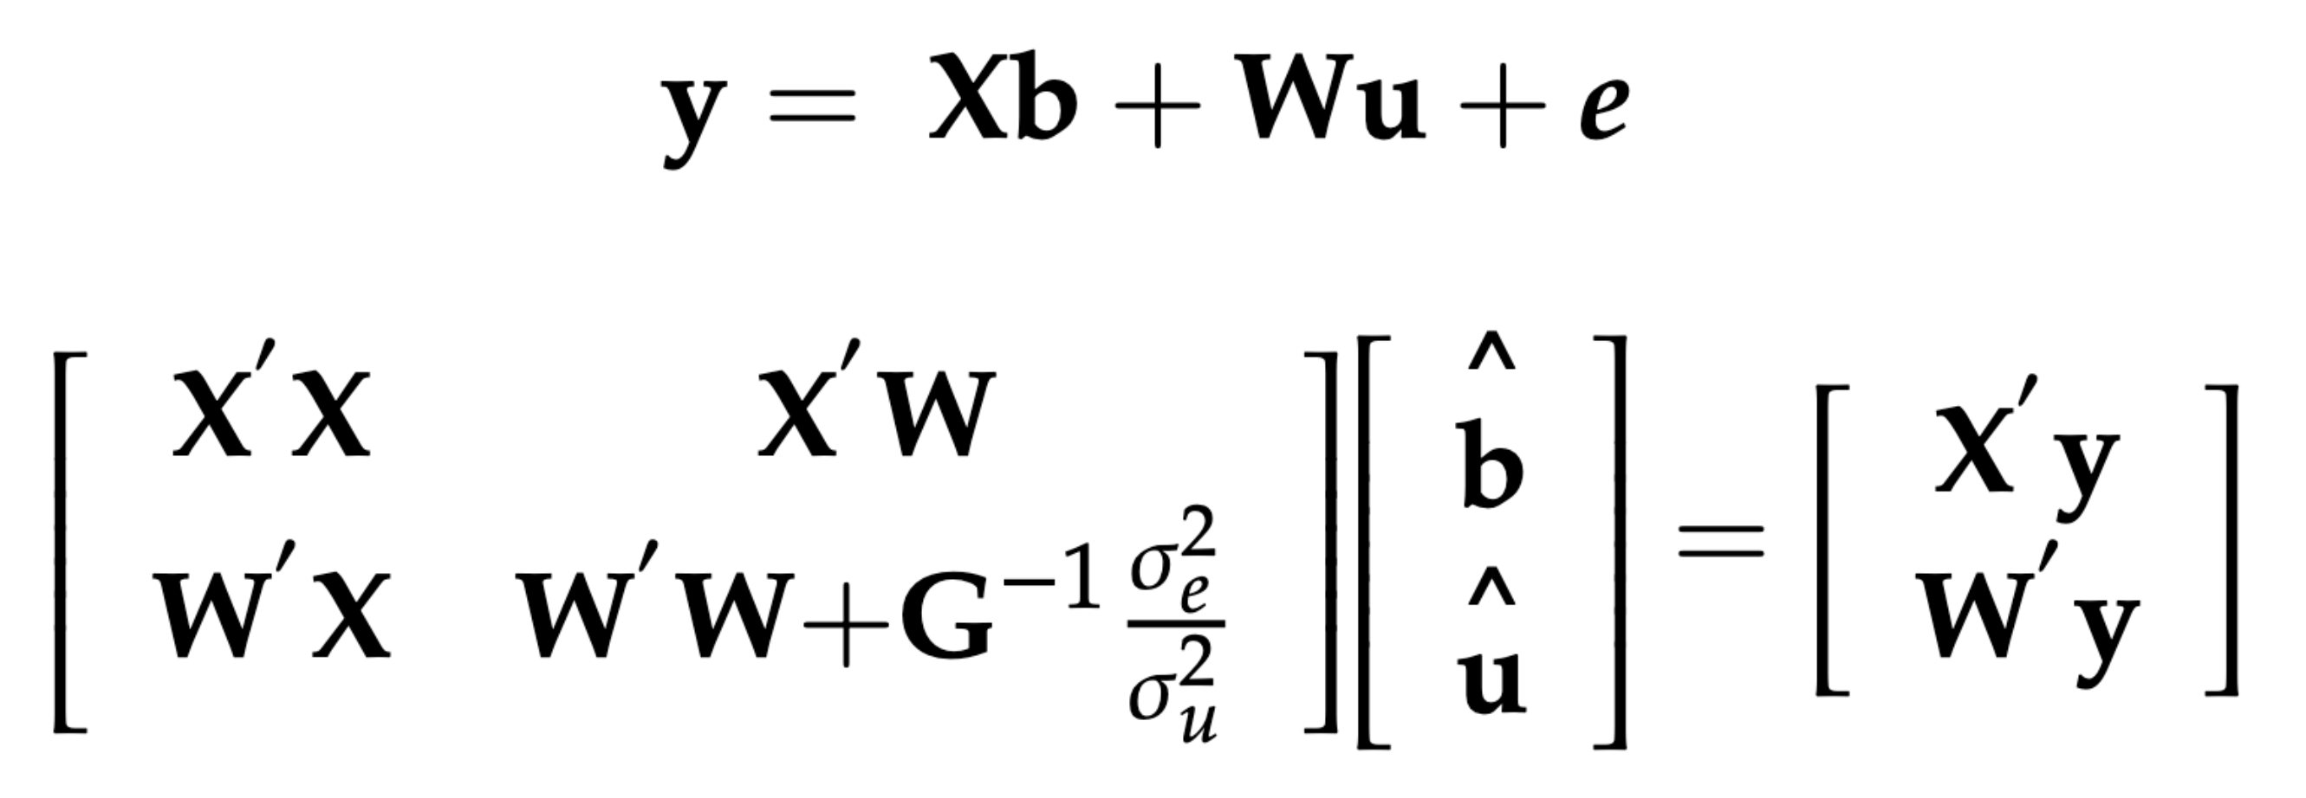
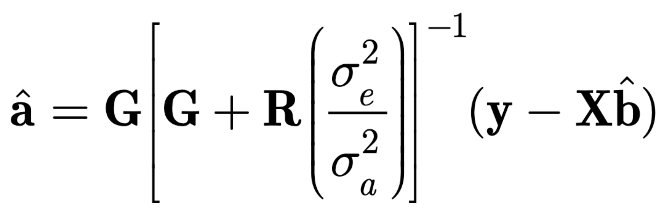
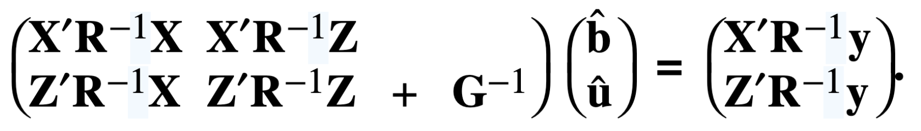
Two-step genomic prediction
Lourenço et al. (2020)
Nejati-Javaremi et al. (1997)
VanRaden et al. (2008)

Slide 13
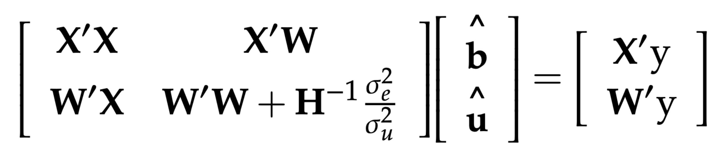
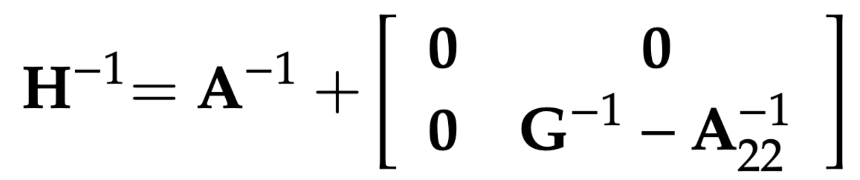
Single-step methodology
Aguilar et al. (2010; https://doi.org/10.3168/jds.2009-2730)

Slide 14
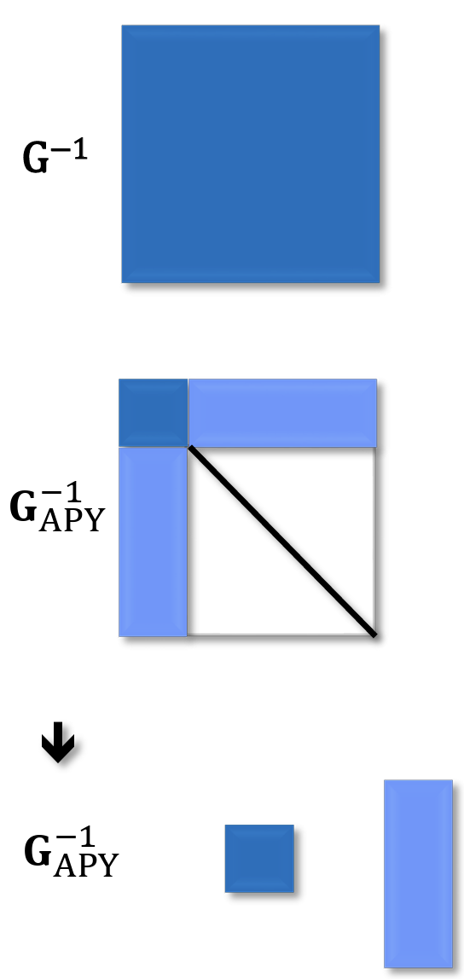
Careful thinking leads to big gains
ssGBLUP problematic when the genotyped population is very large
The Algorithm for Proven and Young (APY) refactors matrices to focus on a core set of animals
Dramatic improvements in performance for large reference populations
Misztal et al. (2014; https://doi.org/10.3168/jds.2013-7752)

Slide 15
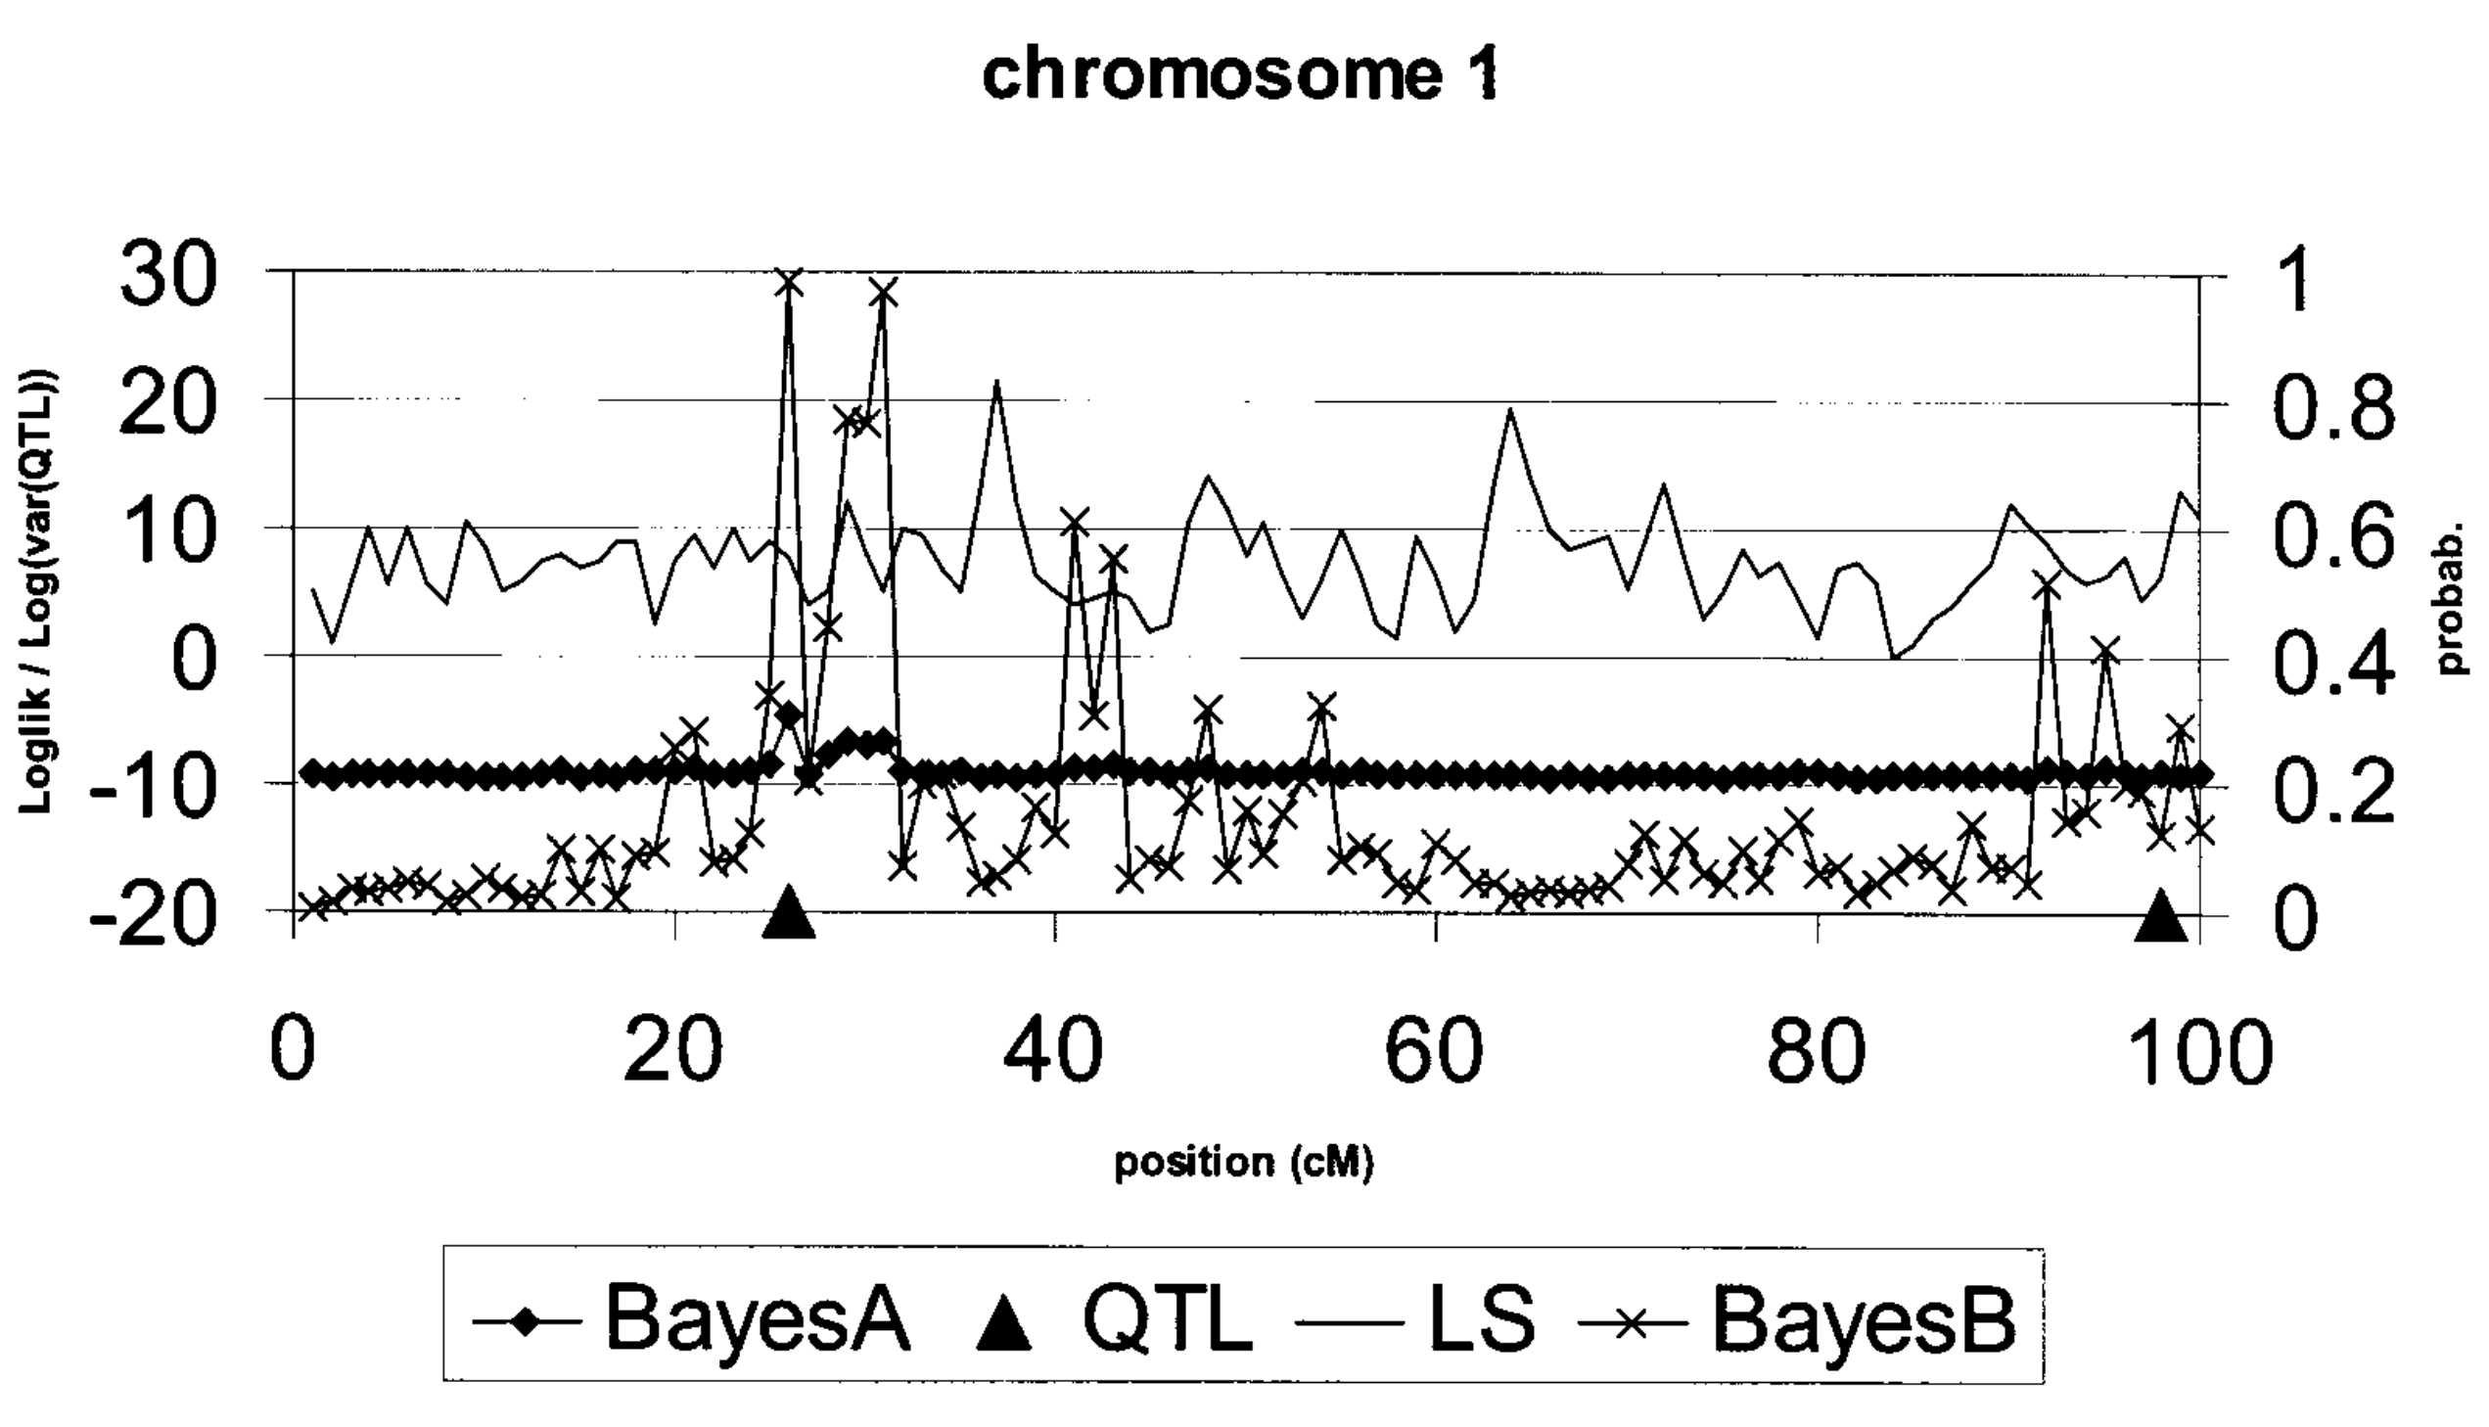
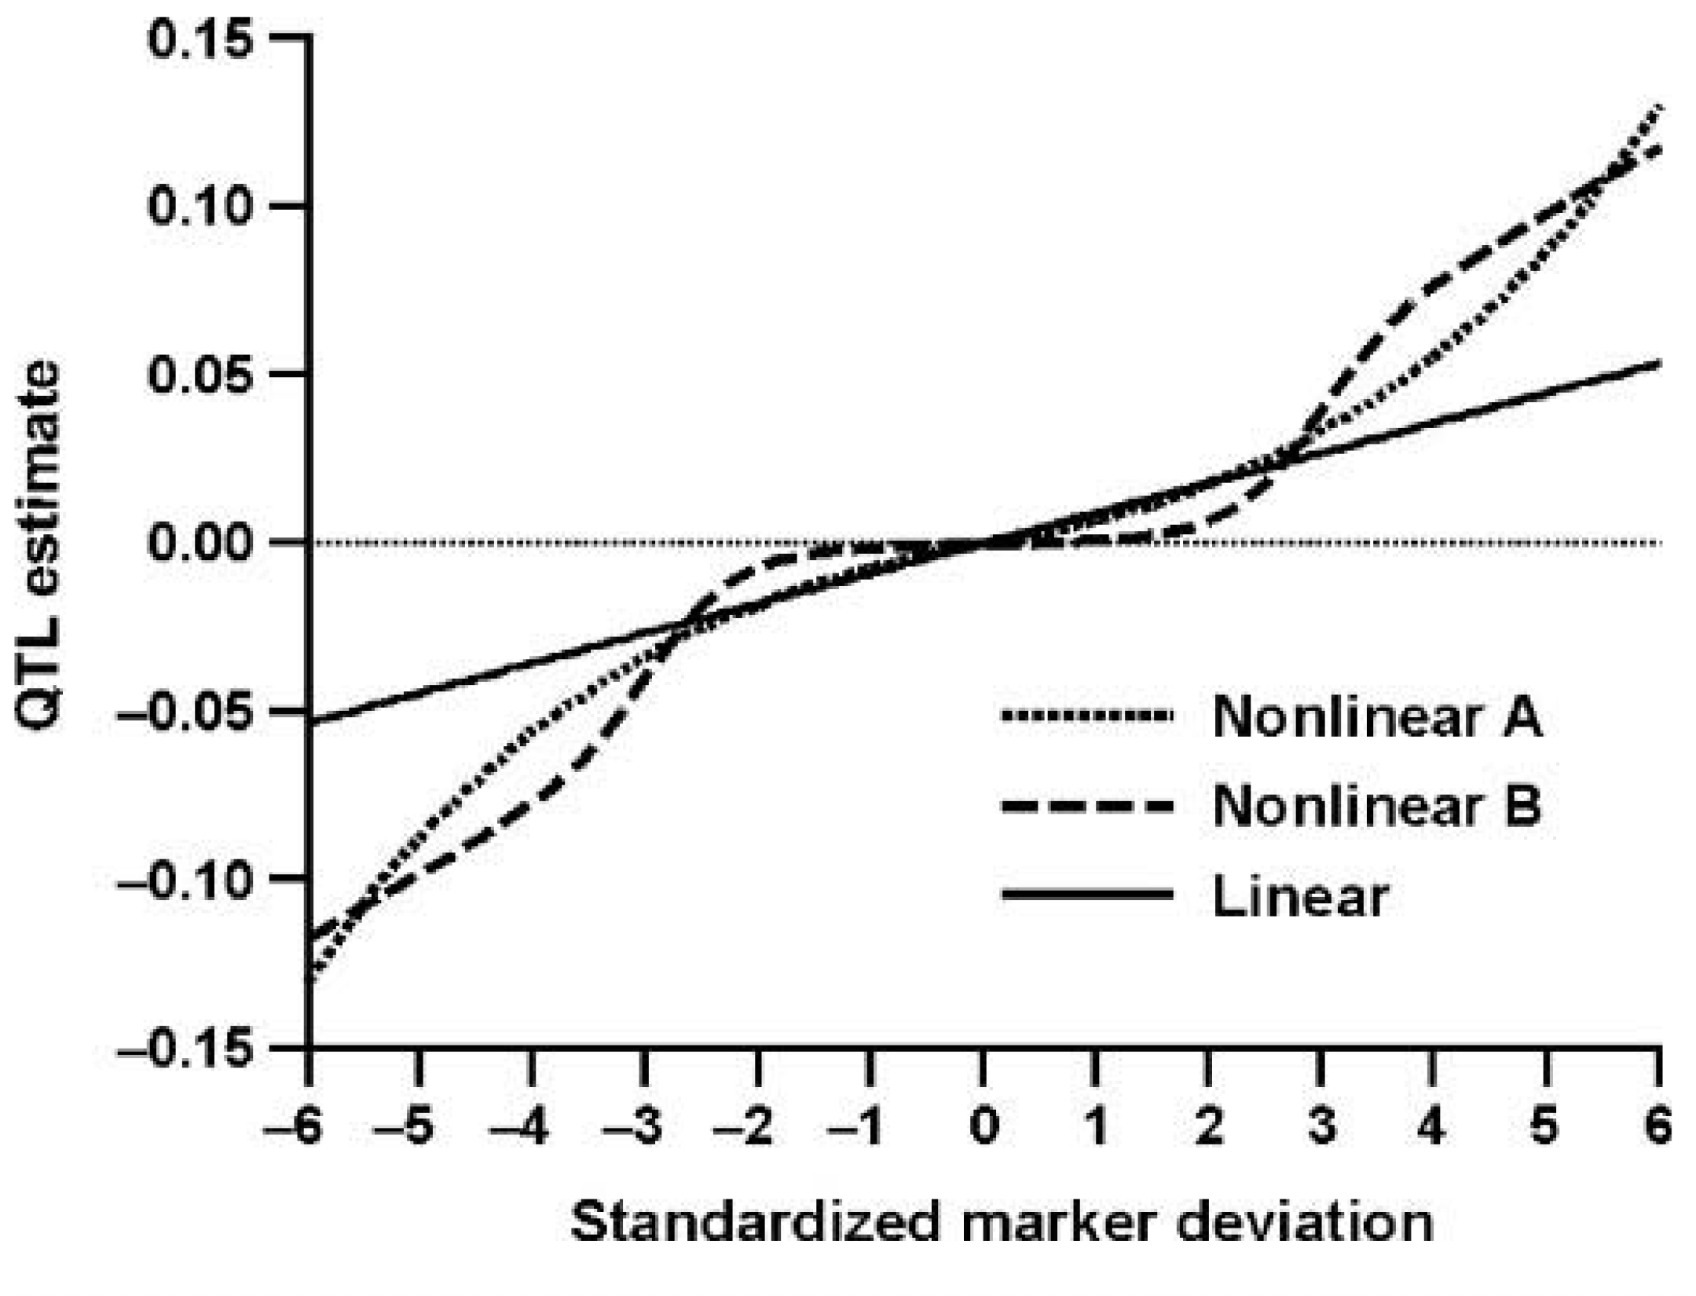
Linear vs. non-linear allele effects
Meuwissen et al. (2001)
VanRaden (2008)

Slide 16
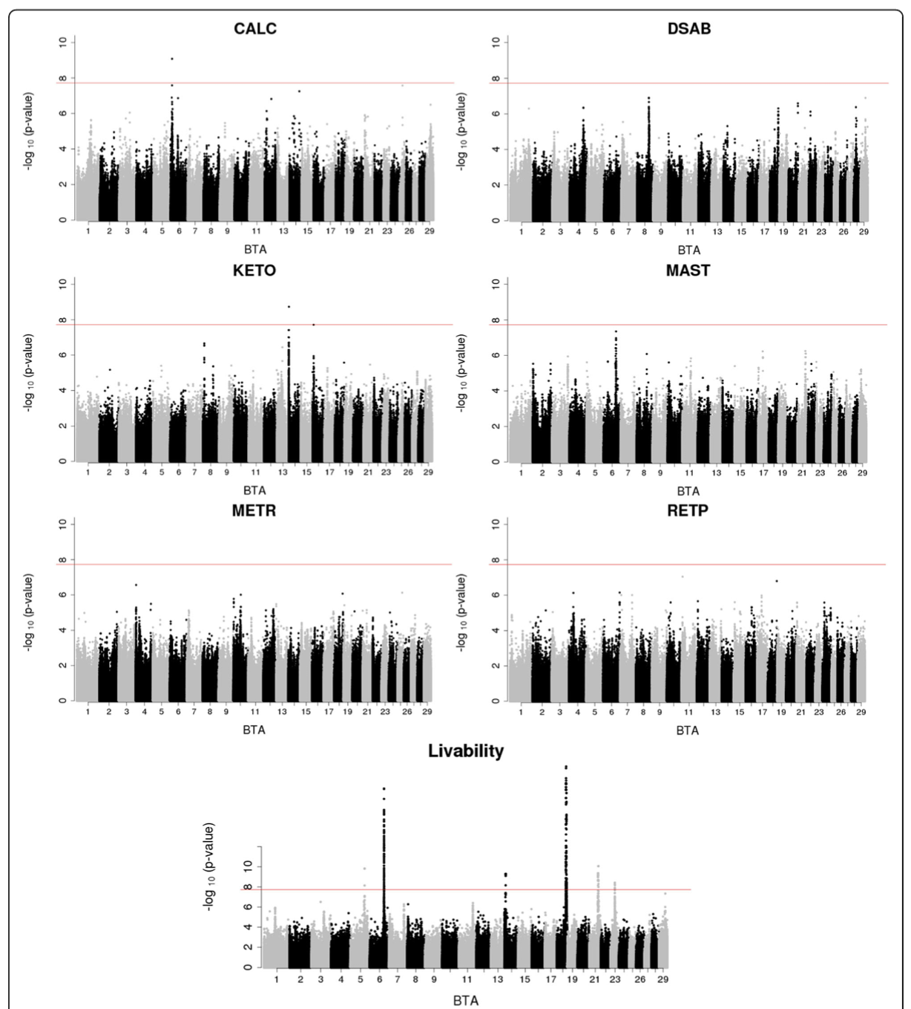
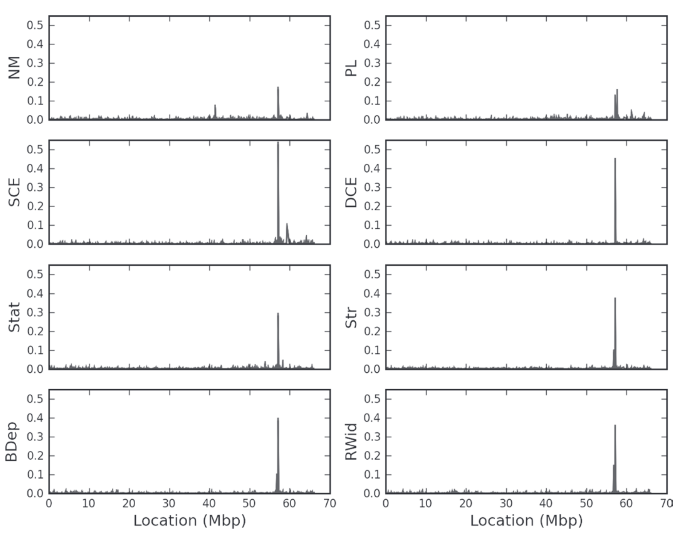
Where are the QTL?
Cole et al. (2009; https://doi.org/10.3168/jds.2008-1762)
Freebern et al. (2020; https://doi.org/10.1101/775098)

Slide 17
Genomic tools

Slide 18
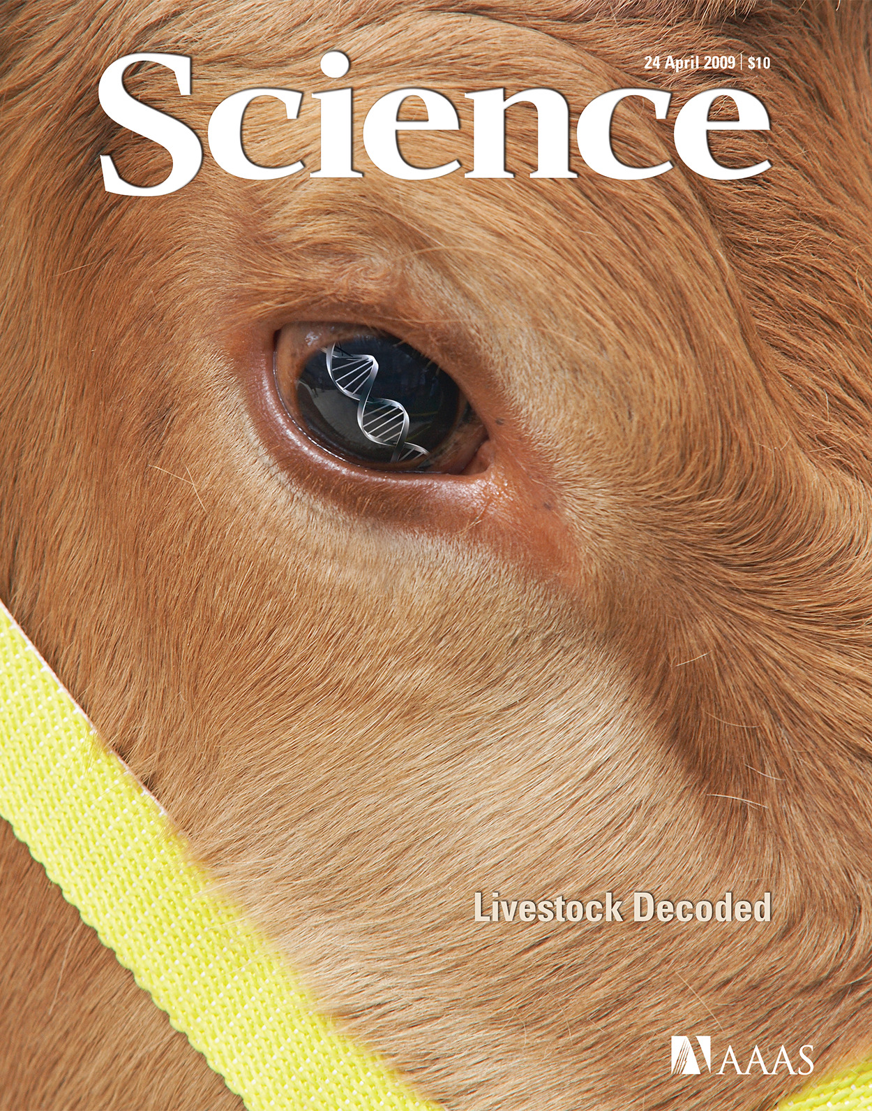
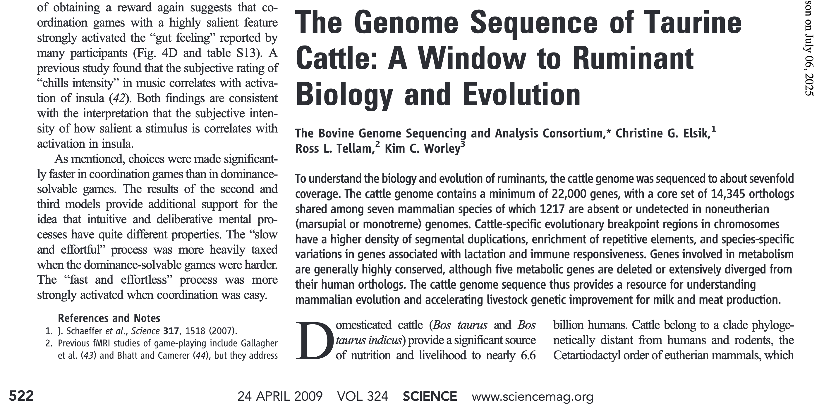
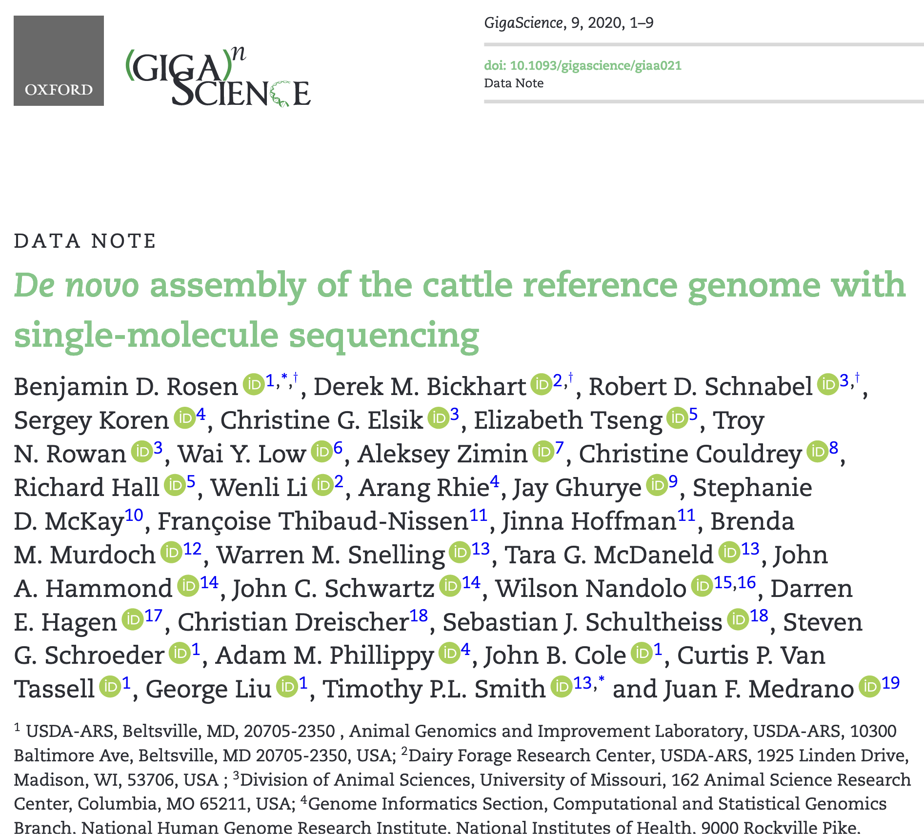
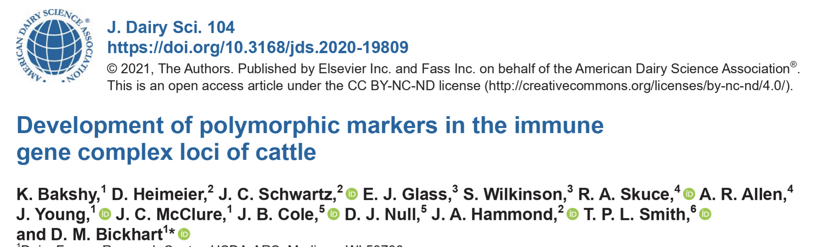
Reference genomes

Slide 19
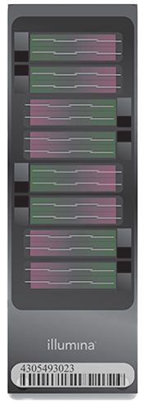
Genotyping arrays
57 chips currently supported
New chips added to:
  Accommodate SNP recently discovered to be important
  Lower costs of genotyping by including subsets of greatest
  interest
  Accommodate new technology
First sequence-based genotypes approved in May
  Low-pass sequence data with enriched targeted regions
Notes:
2

Slide 20
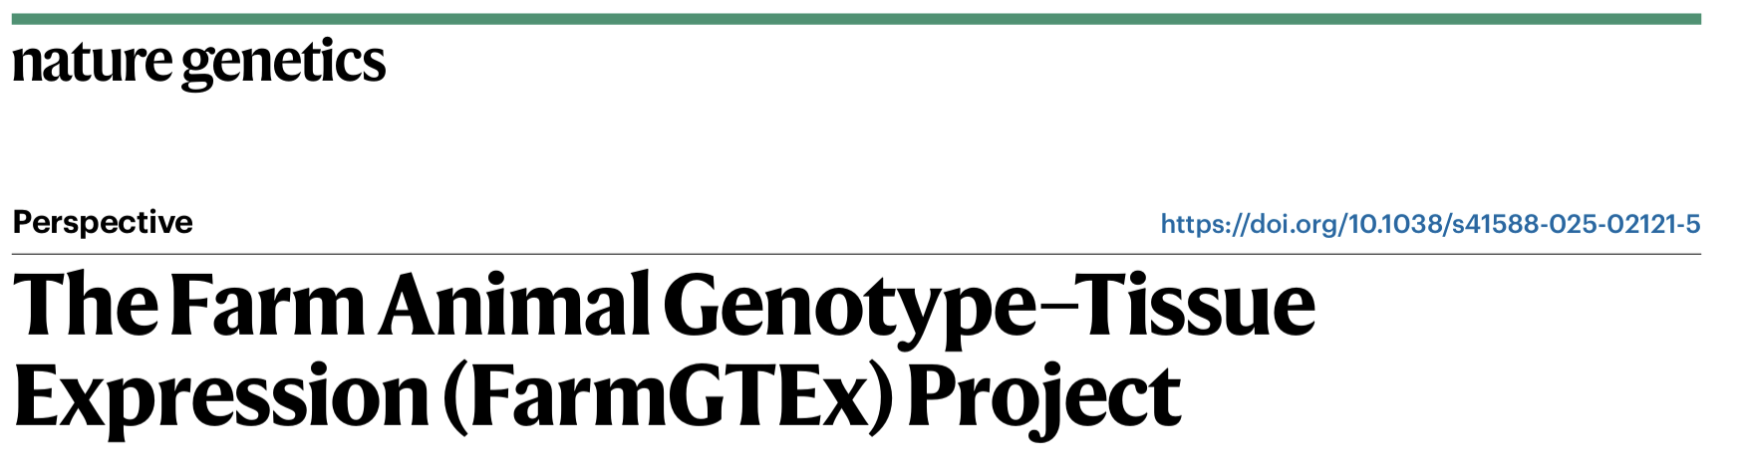
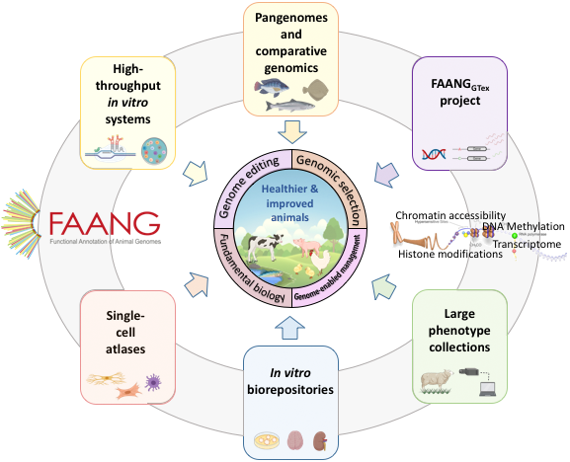
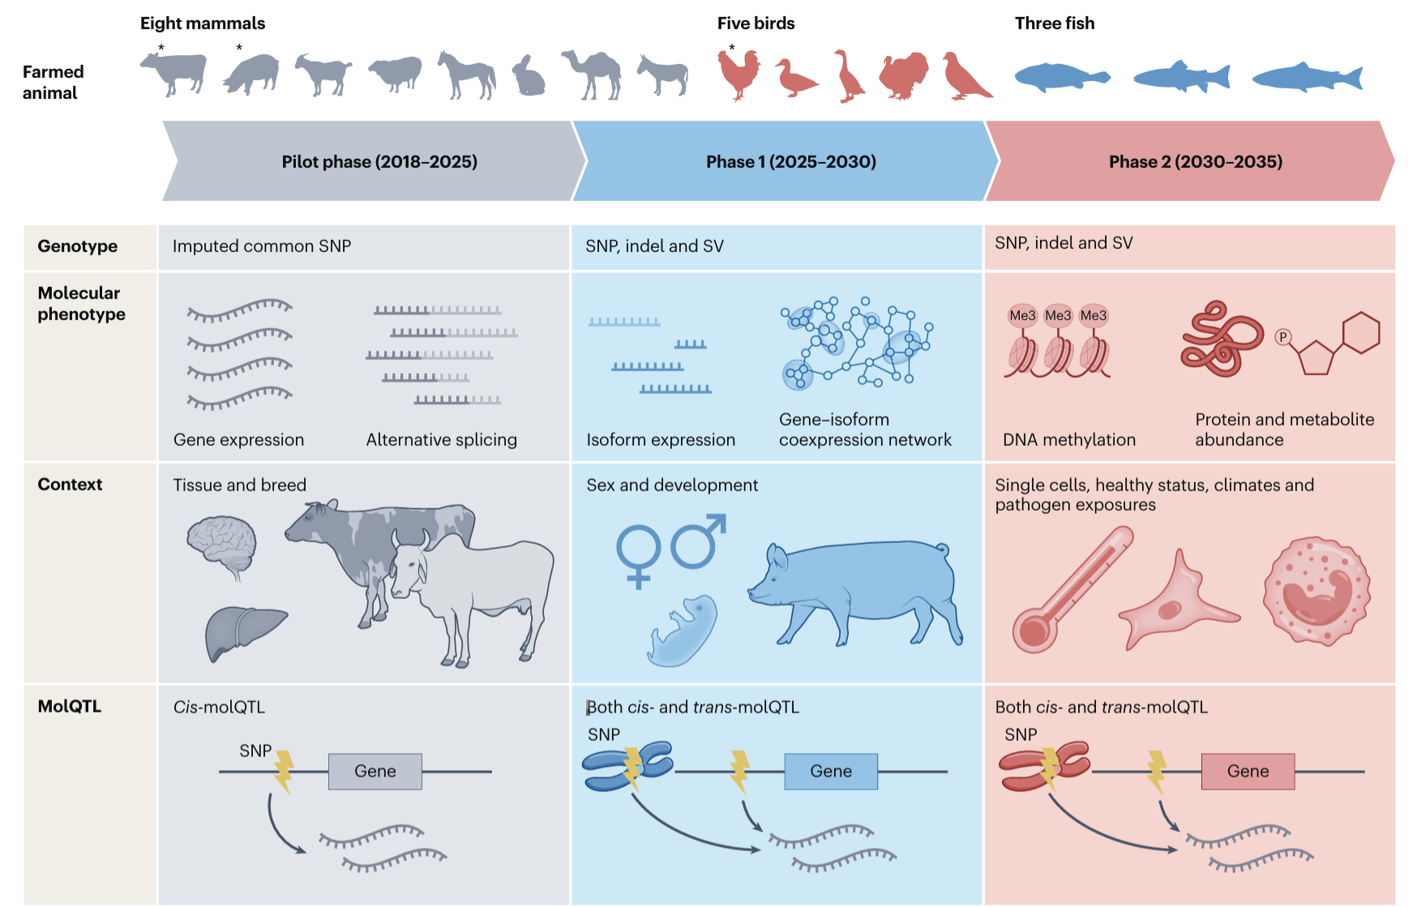
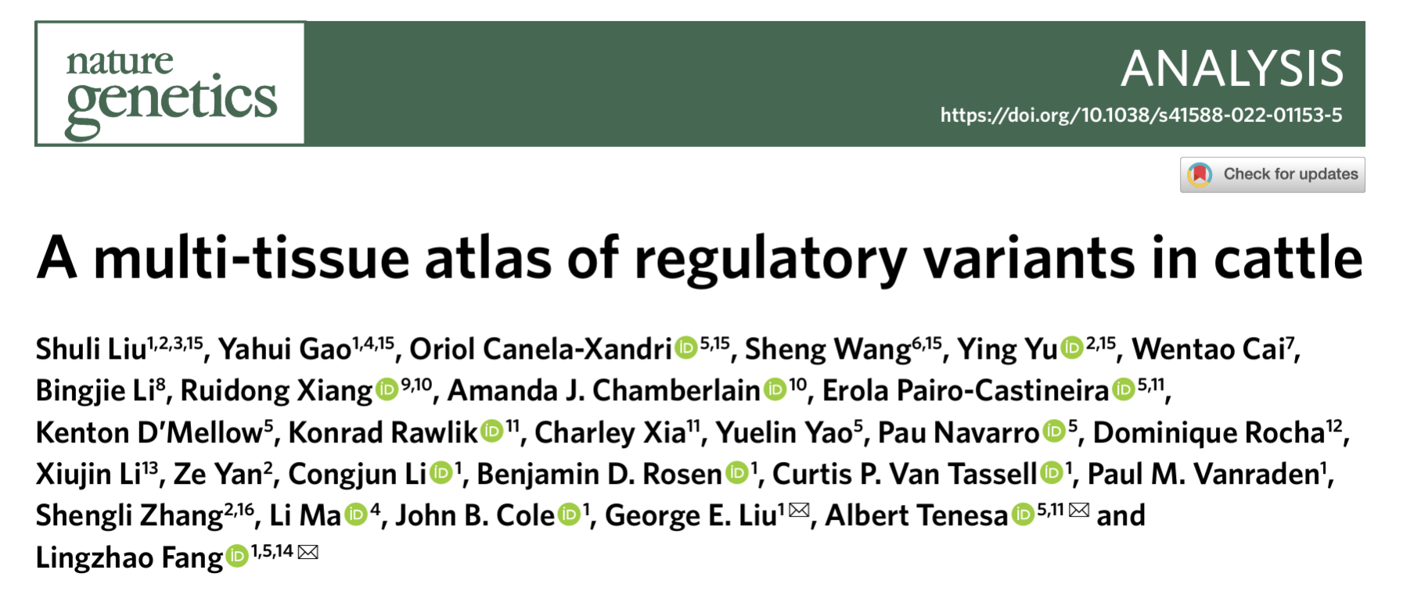
The growth of ‘omics

Slide 21
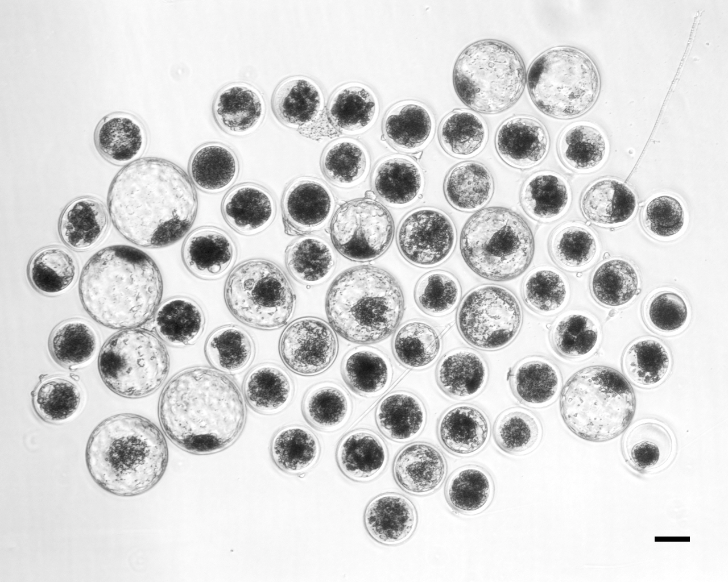
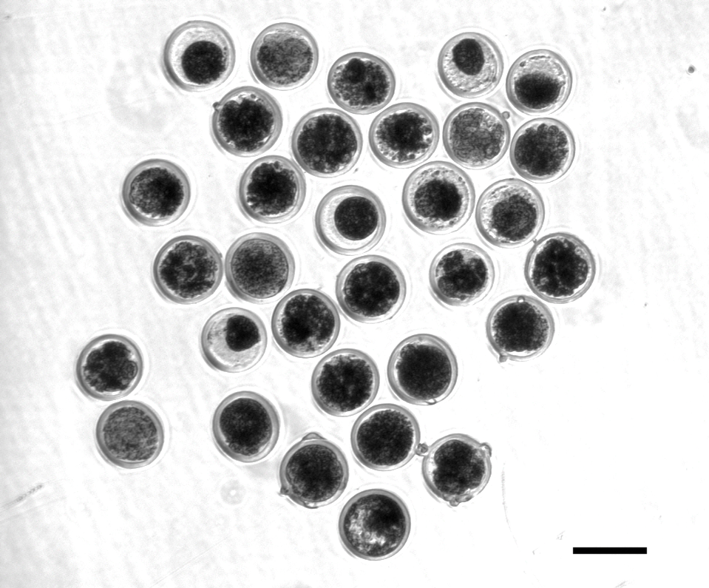
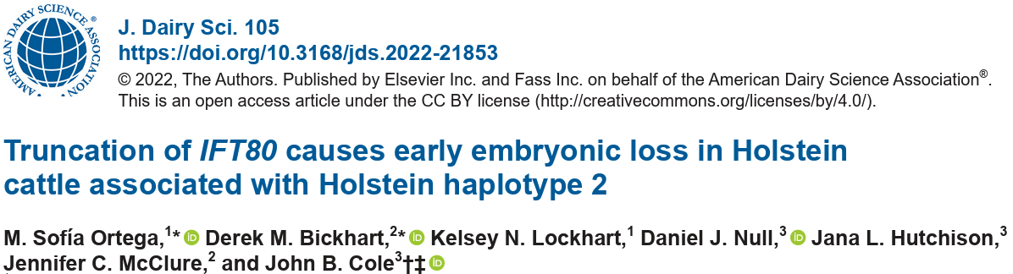
Functional validation of putative causals
A frameshift in IFT80 at 107,172,615 bp (p.Leu381fs) disrupts wnt and hedgehog signaling, and is responsible for the death of homozygous embryos
Control embryos injected with only Cas-9 (left)
Treatment embryos injected with Cas-9 and IFT80 exon 2 guide RNA (right)

Slide 22
Adoption by industry

Slide 23
What influences traits of interest?
Phenotype = Genotype + Management + Environment
Variation attributable to genetics varies:
Female fertility: 0.04
Working life: 0.08
Udder health: 0.12
Milk production: 0.35
Variation due to management practices is large:
Feeding
Housing
Reproductive management
Variation from environmental factors can be important:
Weather (short-term)
Climate (long-term)
Notes:
23
23

Slide 24
Genetic merit of marketed Holstein bulls
Average gain:
$80.65/year
Average gain:
$35.48/year
Average gain:
$2.88/year

Slide 25
Generation interval – Holstein
Genomic evaluations became official for Holsteins in January 2009
Guinan et al. (2023; https://doi.org/10.3168/jds.2022-22205)

Slide 26
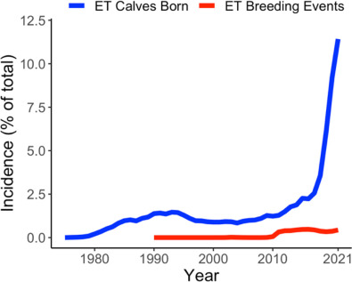
Embryo transfer has grown rapidly
Benefits from ET may be higher than AI due to higher conception rates and faster rates of genetic gain (Kaniyamattam et al., 2017)
Terminal ET programs may help maximize value in complex breeding systems
Miles et al. (2023; https://doi.org/10.3168/jds.2022-22298)

Slide 27
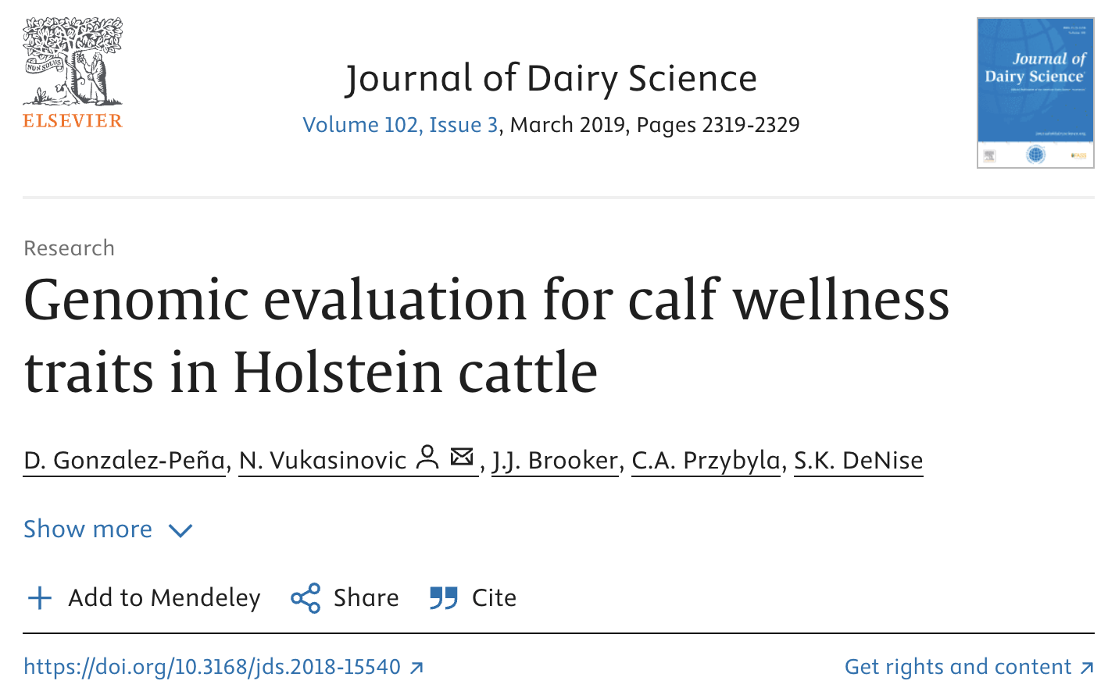
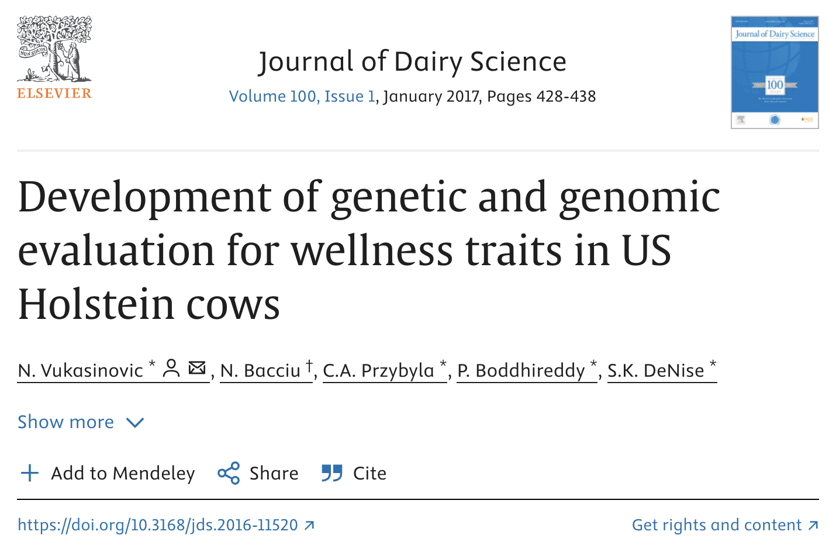
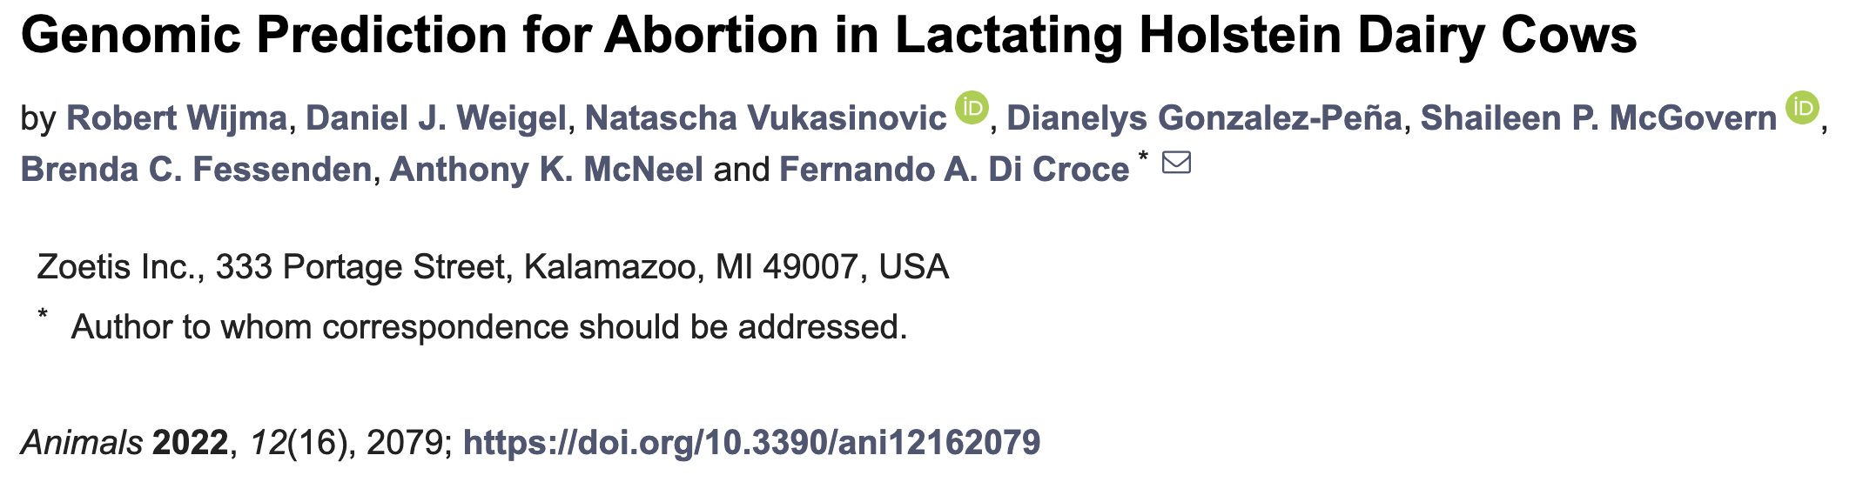
New industry players have emerged
Genetic evaluations for novel traits are being offered by companies that are not genetic evaluation centers
This was not anticipated early in the genomics era

Slide 28
Expensive traits are now within reach
Many traits of economic importance are very expensive to measure and have low heritabilities
Increased reliabilities from genomics make effective genetic selection possible in these cases

Slide 29
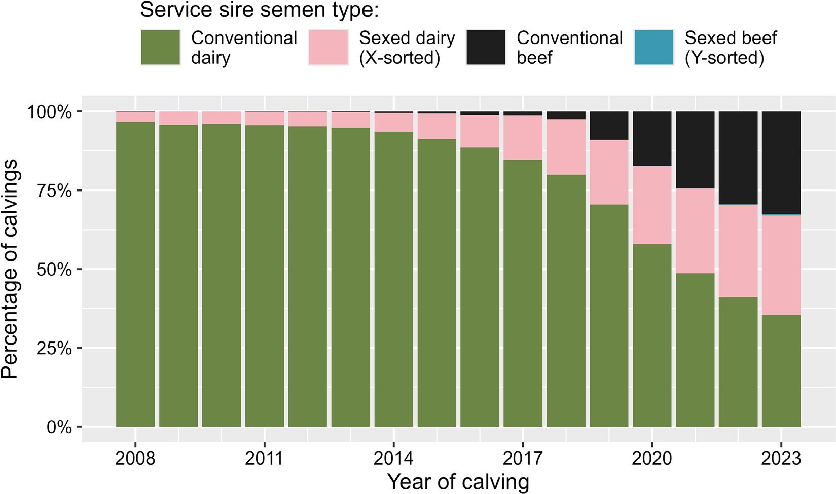
Breeding strategies
The availability of sexed semen at competitive prices and historically high beed prices have led dairy farmers to adopt sophisticated breeding strategies using many new technologies
Basiel et al. (2025; https://doi.org/10.3168/jds.2025-26600)

Slide 30
Selection goals

Slide 31
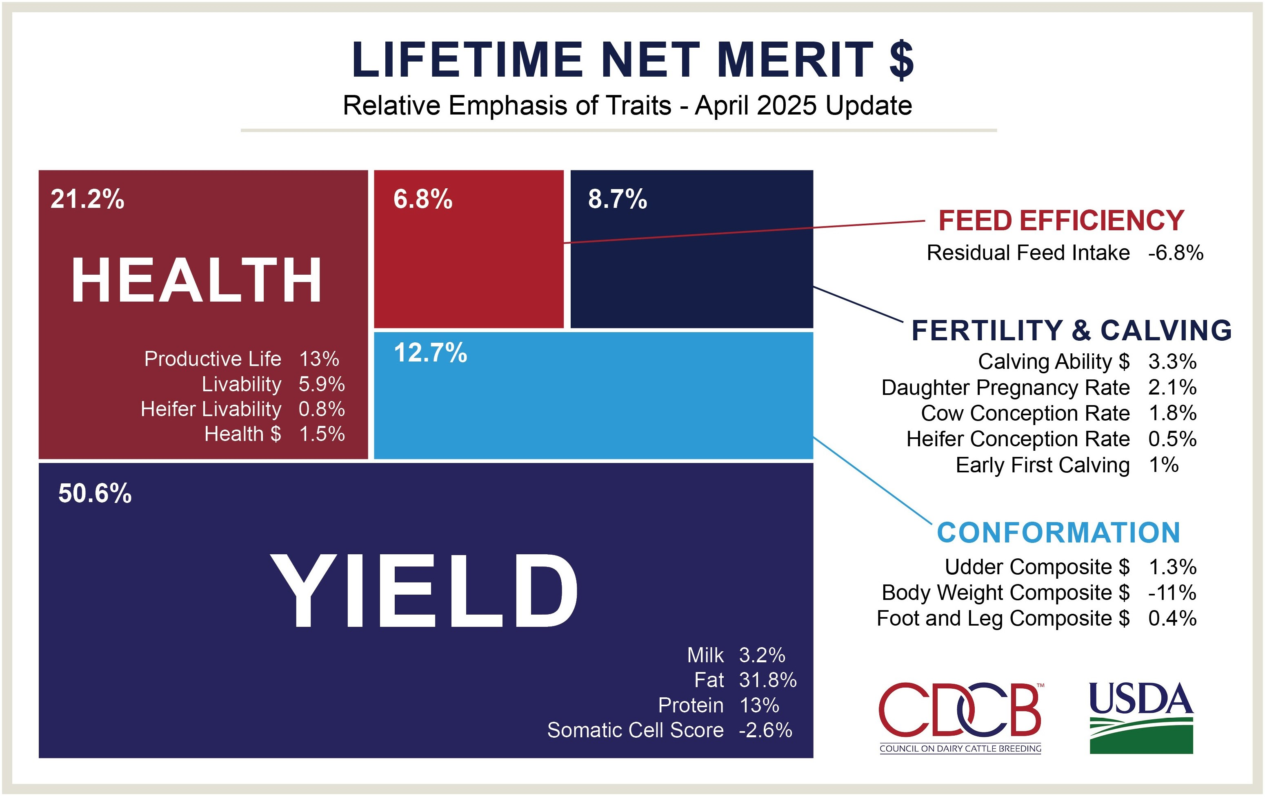
How do we deal with so many traits?

Slide 32
Changes to the index over time (Cole, 2025)
 | PD$ |  | MFP$ | CY$ | NM$94 | NM$00 | NM$06 | NM$10 | NM$14 | NM$17 | NM$18 | NM$21 | NM$25
Milk | 52 | 27 | –2 | 6 | 5 | 0 | 0 | 0 | –1 | –1 | –1 | 0 | 3
Fat | 48 | 46 | 45 | 25 | 21 | 22 | 23 | 19 | 22 | 24 | 27 | 22 | 25
Protein | — | 27 | 53 | 43 | 36 | 33 | 23 | 16 | 20 | 18 | 17 | 17 | 11
PL | — | — | — | 20 | 14 | 11 | 17 | 22 | 19 | 13 | 12 | 15 | 12
SCS | — | — | — | –6 | –9 | –9 | –9 | –10 | –7 | –7 | –4 | –3 | -3
BSC/BWC | — | — | — | — | -4 | -3 | -4 | -6 | -5 | -6 | -5 | -9 | -11
UC | — | — | — | — | 7 | 7 | 6 | 7 | 8 | 7 | 7 | 3 | 1
FLC | — | — | — | — | 4 | 4 | 3 | 4 | 3 | 3 | 3 | 1 | 1
DPR | — | — | — | — | — | 7 | 9 | 11 | 7 | 7 | 7 | 5 | 3
CA$ | — | — | — | — | — | — | 6 | 5 | 5 | 5 | 5 | 3 | 3
HCR | — | — | — | — | — | — | — | — | 1 | 1 | 1 | 1 | 1
CCR | — | — | — | — | — | — | — | — | 2 | 2 | 2 | 1 | 2
LIV | — | — | — | — | — | — | — | — | — | 7 | 7 | 4 | 6
HTH$ | — | — | — | — | — | — | — | — | — | — | 2 | 2 | 2
RFI | — | — | — | — | — | — | — | — | — | — | — | –12 | -14
EFC | — | — | — | — | — | — | — | — | — | — | — | 1 | 1
HLIV | — | — | — | — | — | — | — | — | — | — | — | 1 | 1

Slide 33
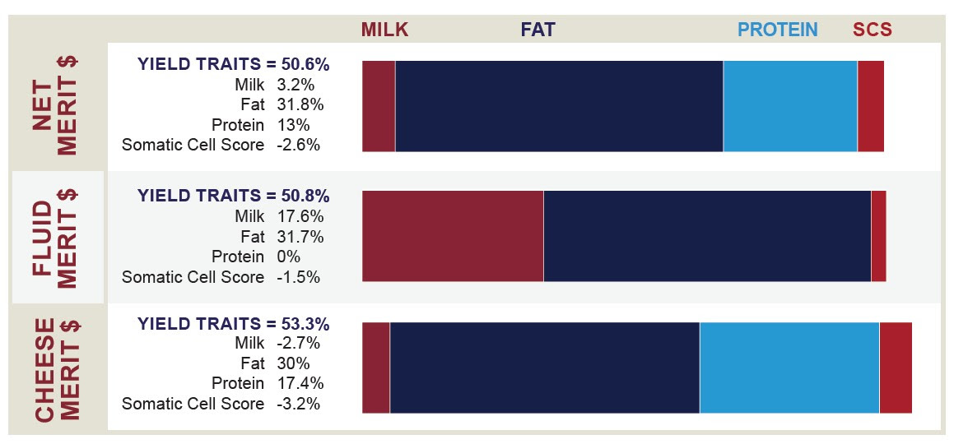
Indices differ by payment scheme

Slide 34
CDCB (2025; https://webconnect.uscdcb.com/#/summary-stats/genetic-trend)

Slide 35
What’s the best animal we can make?
PTA(NM$) = $3,652 (R$18,260)
The top bull is GENOSOURCE ENDURANCE-ET at $1,233 (R$6,165)
The top cow is OCD RIPCORD ZENITH-ET at $1,385 (R$6,925)
Cole & VanRaden (2011; https://doi.org/10.1111/j.1439-0388.2011.00922.x)

Slide 36
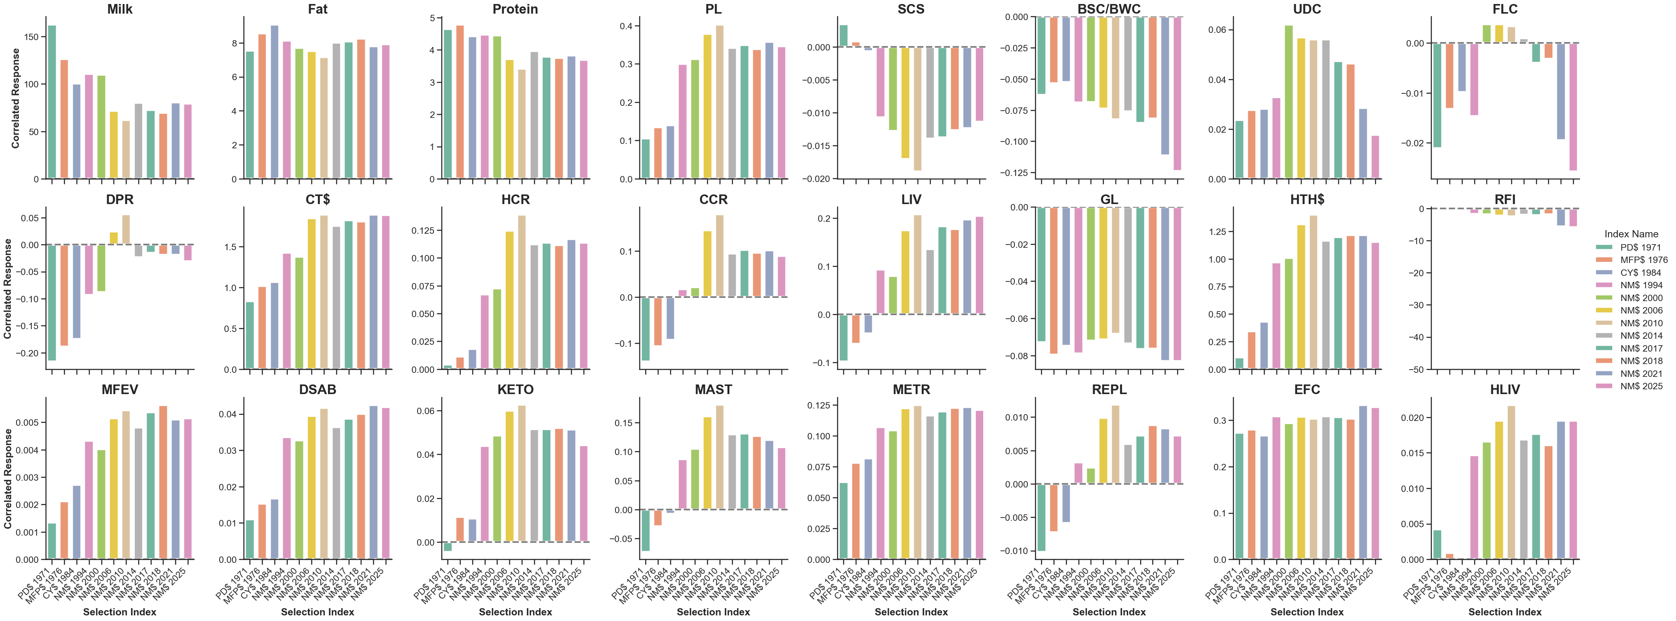
Are there too many traits in the index?
Cole (2025; https://doi.org/10.3168/jds.2024-25833)

Slide 37
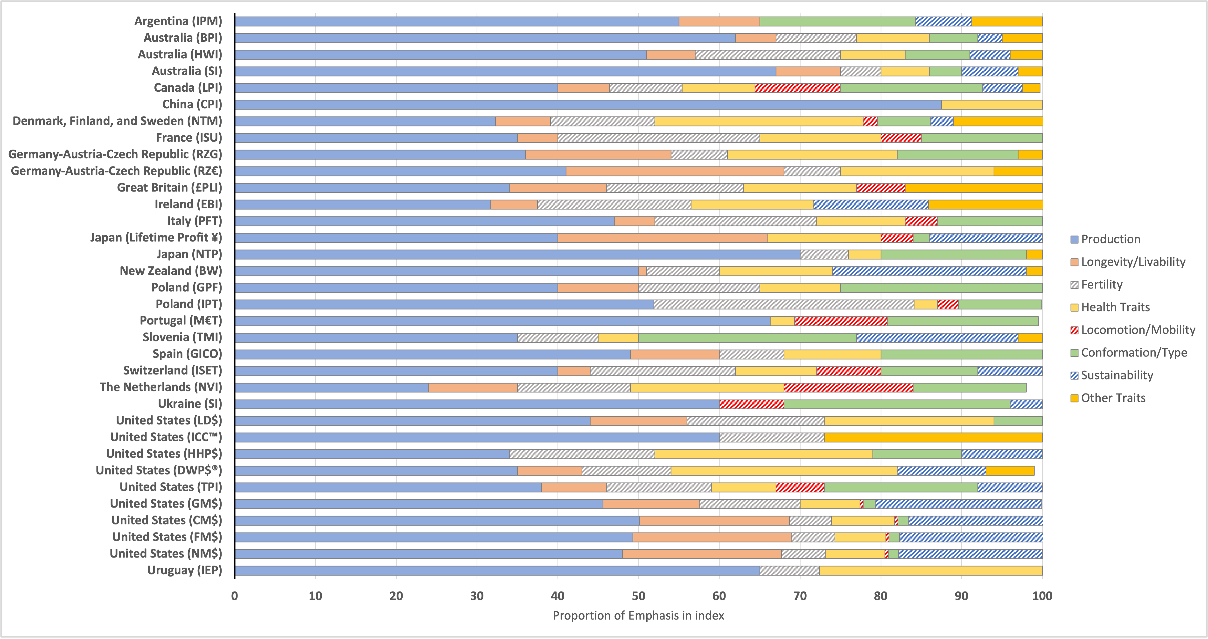
Cole (2025; https://doi.org/10.17605/OSF.IO/6GFTB)

Slide 38
Future directions

Slide 39
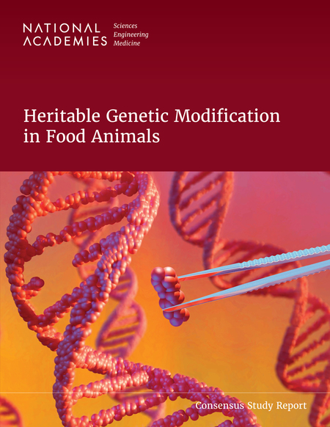
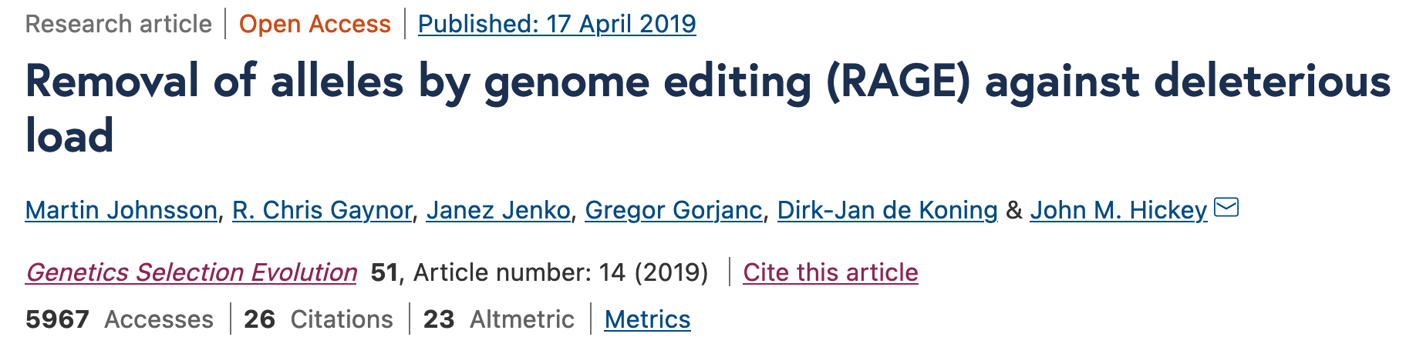
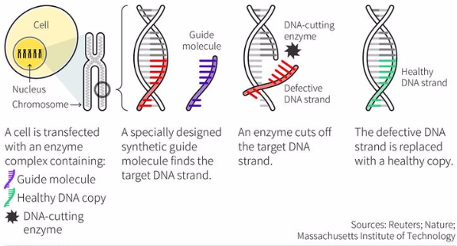
Gene editing
Can we use gene editing to “fix” defects when we find them?
Then we can get rapid genetic gain without negative consequences!
But do we know what we loci need to edit?

Slide 40
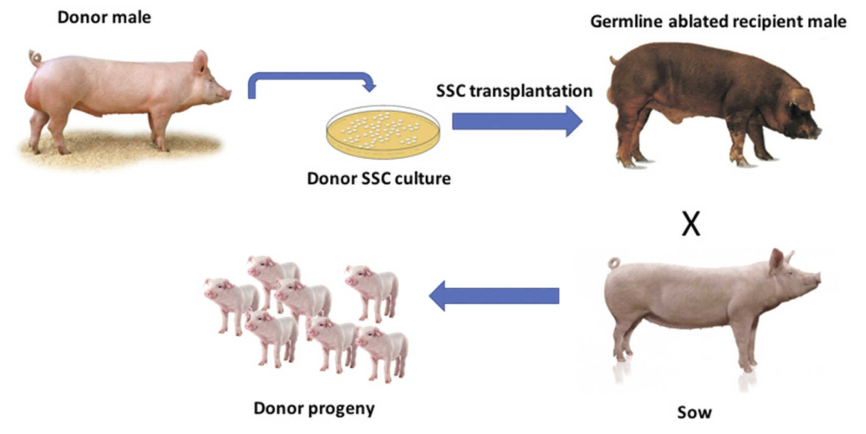
Surrogate sires
Implant stem cells of genetically elite animals into surrogates, which produce the donor’s gametes
Multiplies germplasm available for breeding
Substantial technical hurdles remain, but progress is being made

Slide 41
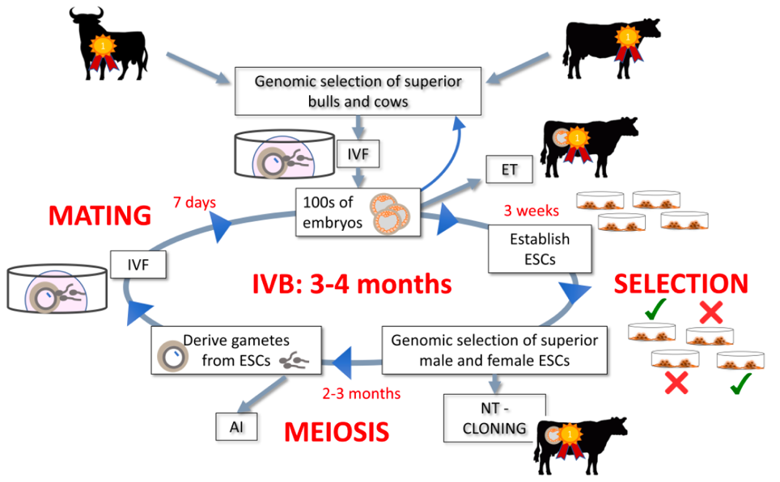
In vitro breeding
Embryonic stem cells can be turned into sperm and eggs and used to create a new generation of embryos (Goszczynski et al., 2018, PMID: 30551176)
Faster genetic gain because time needed to create next generation is shortened
Live animals eventually needed

Slide 42
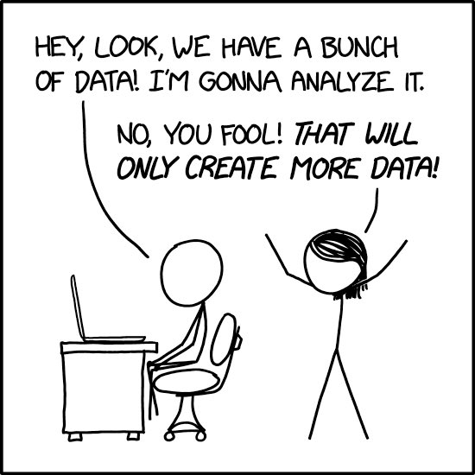
The promise of prediction
Many data now available to farmers
Can be used to predict cow performance
Also may support precision management schemes

Slide 43
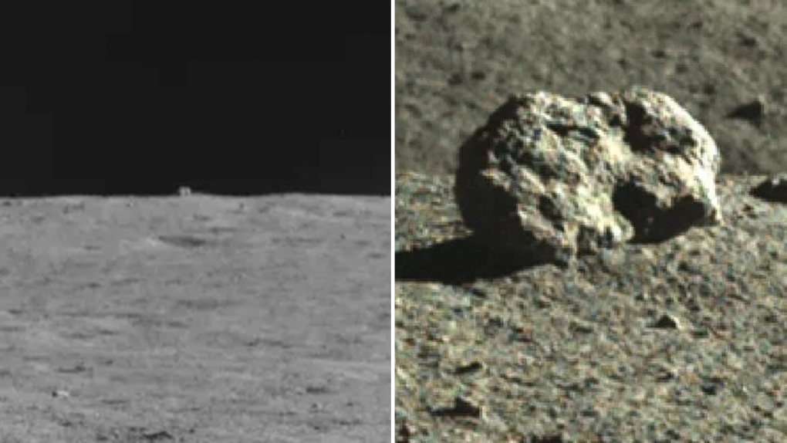
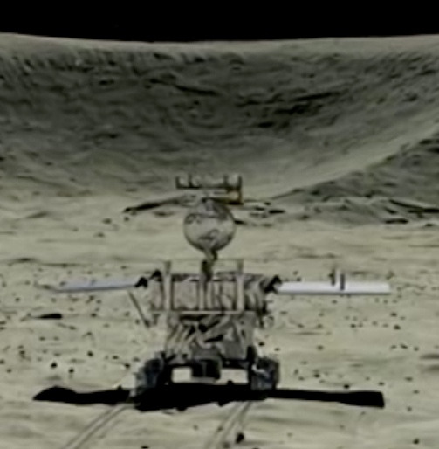

Some perils of prediction

Slide 44

Teamwork is essential
Not shown: Dan Null, Senior Support Scientist

Slide 45
Acknowledgments
USDA-ARS project 8042-31000-113-00-D, “Improving Dairy Animals by Increasing Accuracy of Genomic Prediction, Evaluating New Traits, & Redefining Selection Goals”
PEAK Genetics, Madison, WI
Council on Dairy Cattle Breeding, Bowie, MD
Department of Animal Sciences, Donald Henry Barron Reproductive and Perinatal Biology Research Program, and the Genetics Institute, University of Florida, Gainesville
Department of Animal Science, North Carolina State University, Raleigh
Department of Animal Biosciences, University of Guelph, Ontario, Canada

Slide 46
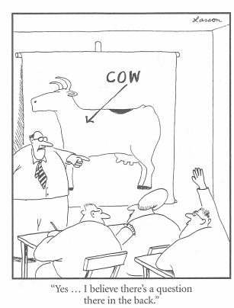
Questions?
Thank you for your
attention!
john.cole@uscdcb.com

